Slide 1

Predicting Market Sector ETF Prices with a Sequential Neural Network
Hayden Sterling
Statistics 362
Fall 2025

Slide 2
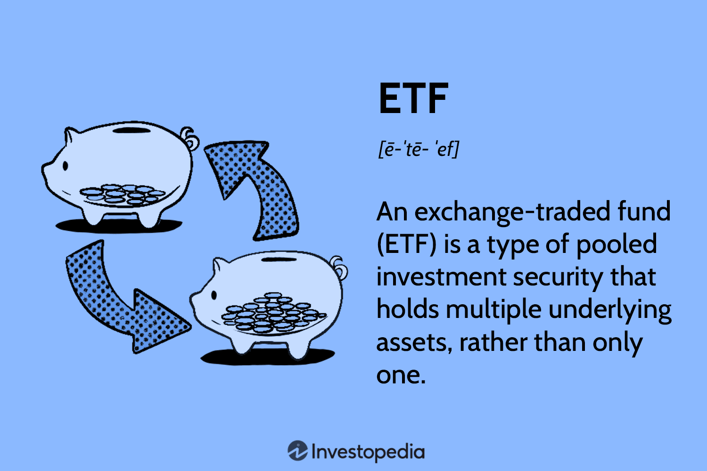
Background
Exchange-Traded Funds (ETFs) track the aggregated performance of an entire sector through a weighted average.
Two key considerations when analyzing market fluctuations:
  1. Sector performance is driven by a range of factors - prior price, investor sentiment, macroeconomic conditions, etc.
  2. Sectors do not move independently of one another (ex. the oil industry).
(Chen)

Slide 3
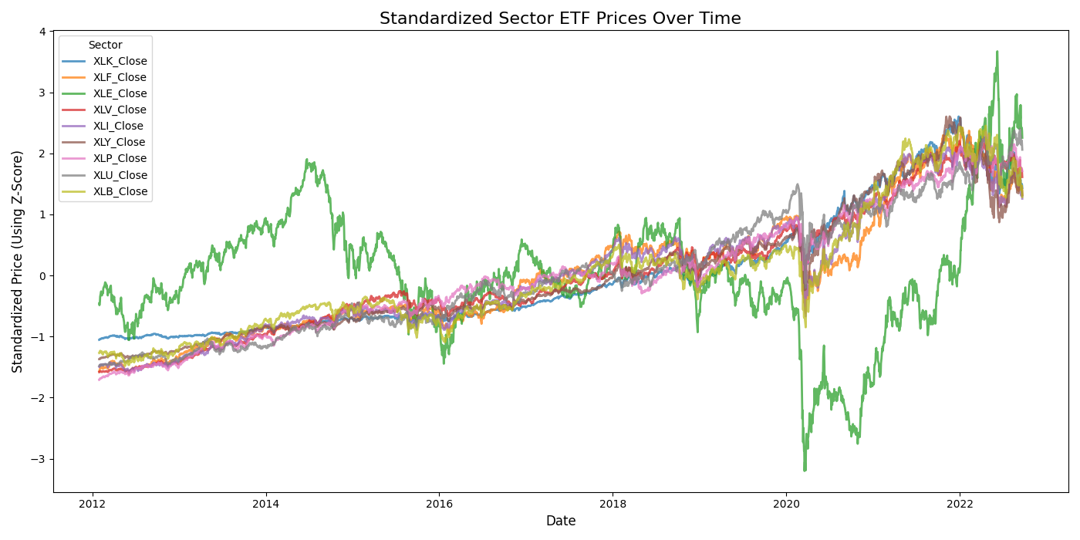
Technical Motivation
LSTM models have historically been successful in forecasting individual stock price (Li).
Although predicting future prices (as opposed to returns) has limited value in trading stocks, it instead helps answer analytical questions such as: does previous market information have predictive power over future prices?
Main goal: This project investigates whether the task of forecasting an individual stock can be expanded to forecasting multiple markets through their sectors ETFs jointly in one, unified model.
Specifically, the model will account for the interdependency of markets through shared multivariate impacts - each sector’s features (prices, volumes, etc.) can influence the predictions of another sector.
This is a multivariate regression problem attempting to predict a 9-dimensional vector, representing the next-day prices of nine sector ETFs.

Slide 4
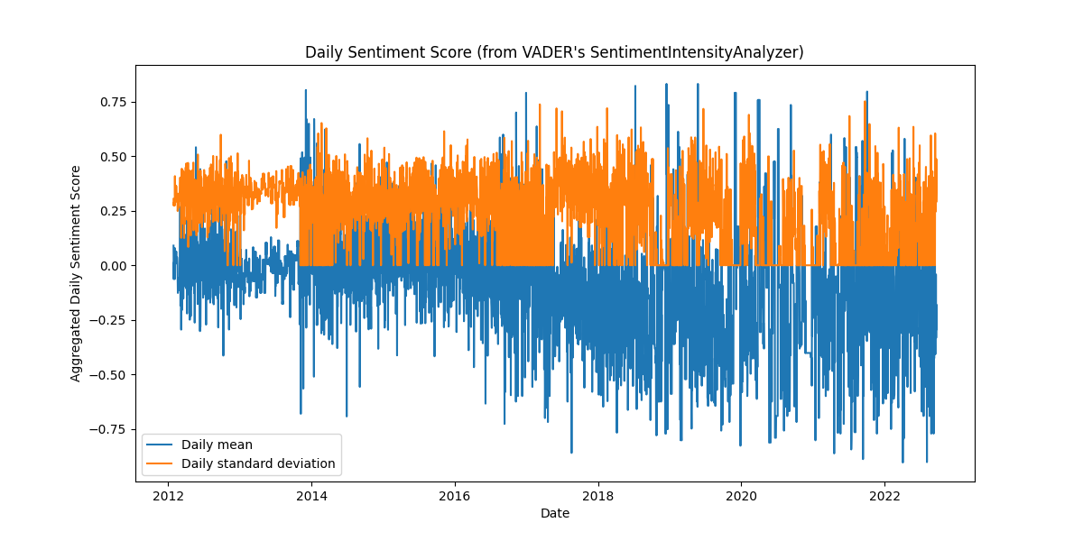
Technical Motivation, cont.
Additionally, to account for the wide range of factors influencing future stock prices, I include news sentiment data as part of the features to model how investor sentiment affects market prices.
A secondary goal is thus to determine the effect (if any) that news sentiments exert on stock prices.

Slide 5
Market Sector ETFs
The following ETFs were used for the model:
XLK - Technology Select Sector SPDR Fund
XLF - Financial Select Sector SPDR Fund
XLE - Energy Select Sector SPDR Fund
XLV - Health Care Select Sector SPDR Fund
XLI - Industrial Select Sector SPDR Fund
XLY - Consumer Discretionary Select Sector SPDR Fund (non-essential goods)
XLP - Consumer Staples Select Sector SPDR Fund (essential goods)
XLU - Utilities Select Sector SPDR Fund
XLB - Materials Select Sector SPDR Fund

Slide 6
Dataset Overview
Two datasets:
1. The yfinance package to extract financial data (“Yfinance”).
2. Kaggle’s News Category Dataset for daily news headlines (Mirsa).
Number of samples: 2,680 trading days from 1/30/2012 to 9/21/2022.
Input features: time sequences of features from 60 previous days.
  Prices (close, high, low, open) and volumes for all 9 ETFs.
  Sentiment scores - daily mean, daily standard deviations, and number of daily news headlines. These were extracted using the VADER pretrained sentiment analysis model: VADER: SentimentIntensityAnalyzer.
Target Variable: 9 close prices from the 9 ETFs on the next day .
Preprocessing Steps:
  Aggregating news headlines by day and using VADER to extract the daily polarity scores.
  Standardization of target (using rolling statistics) and features (using per window statistics).
  Creation of data sequences, using a specified look-back period (60 days by default)
Prices
Volumes
Standardization (per-window for features, rolling statistics for target
Merging
Sequence creation & Data Splitting
LSTM Model
News headlines
VADER Sentiment Intensity Analyzer
Input (3-dimensional tensor): (# training examples, # days, # features) = (1815, 60, 48)
Output (9-dimensional vector at each timestamp): (# training examples, # outputs) = (1815, 9)

Slide 7
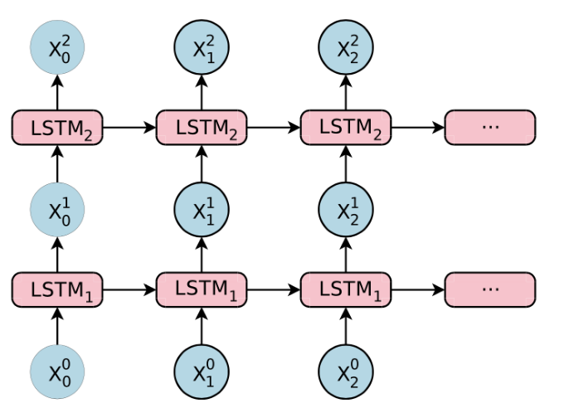
Approach Overview
A one sentence overview of the deep learning approach:
A multivariate LSTM model is trained to learn temporal patterns across 9 market sector ETFs and predict their next-day prices jointly from historical market and sentiment features, with the LSTM sharing weights across sectors, allowing information from one sector to influence the others.
(Stack Overflow)

Slide 8
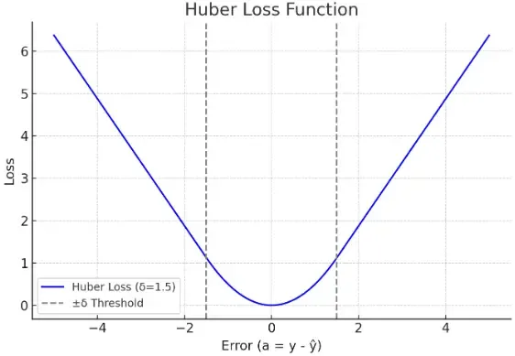
Model Architecture & Design Choices
Model architecture: Stacked LSTM
Overfitting risks in financial data → heavy focus on reducing overfitting.
Important design choices:
Huber loss function
  Less sensitive to extreme outliers (which are very common in financial data).
Heavy regularization (reducing noise)
  Kernel and recurrent L2 regularization on all LSTM layers
  Dropout on LSTM layers and dense layers
Model callbacks
  Early stopping to prevent extreme overfitting between epochs
  Learning rate scheduler for continual fine-tuning of weights
Batch size: 32
Epochs: 100 (intentionally high due to early stopping)
Nearly every model design choice was made with the intention of reducing overfitting. Financial data is extremely noisy, and hence very easy to overfit.
(“Huber”)

Slide 9
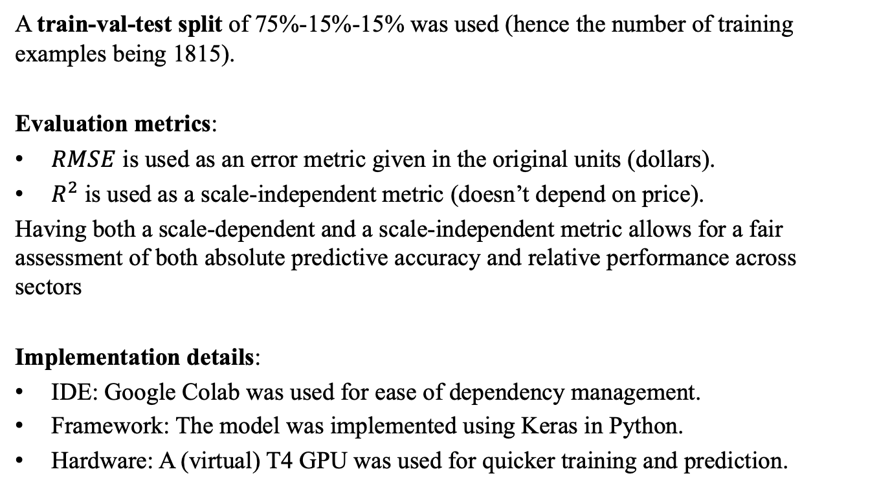
Experimental Setup
A train-val-test split of 75%-15%-15% was used (hence the number of training examples being 1815).
Evaluation metrics:
$RMSE$ is used as an error metric given in the original units (dollars).
$R^{2}$ is used as a scale-independent metric (doesn’t depend on price).
Having both a scale-dependent and a scale-independent metric allows for a fair assessment of both absolute predictive accuracy and relative performance across sectors
Implementation details:
IDE: Google Colab was used for ease of dependency management.
Framework: The model was implemented using Keras in Python.
Hardware: A (virtual) T4 GPU was used for quicker training and prediction.

Slide 10
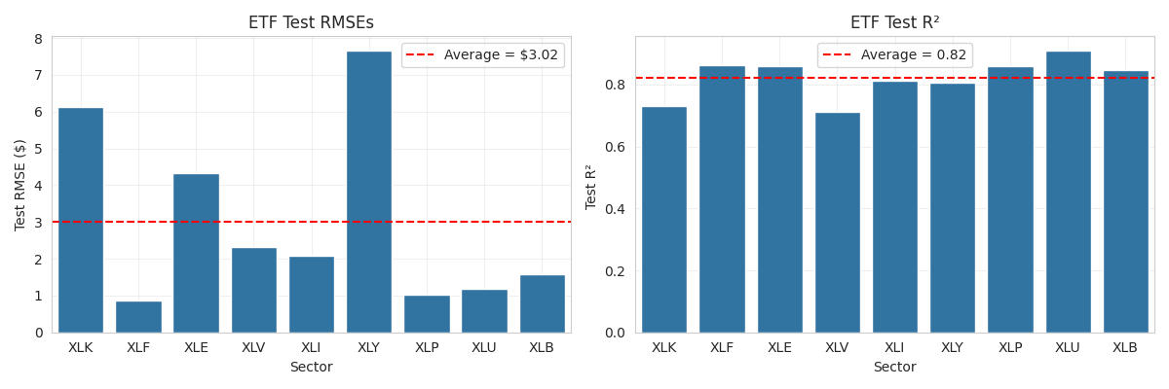
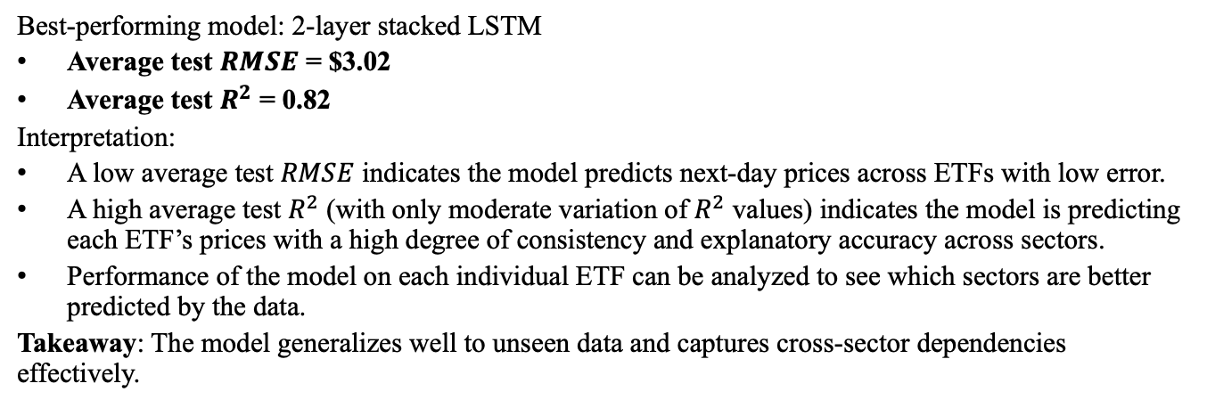
Key Results
Best-performing model: 2-layer stacked LSTM
Average test $RMSE$ = $3.02
Average test $R^{2}$ = 0.82
Interpretation:
A low average test $RMSE$ indicates the model predicts next-day prices across ETFs with low error.
A high average test $R^{2}$ (with only moderate variation of $R^{2}$ values) indicates the model is predicting each ETF’s prices with a high degree of consistency and explanatory accuracy across sectors.
Performance of the model on each individual ETF can be analyzed to see which sectors are better predicted by the data.
Takeaway: The model generalizes well to unseen data and captures cross-sector dependencies effectively.

Slide 11
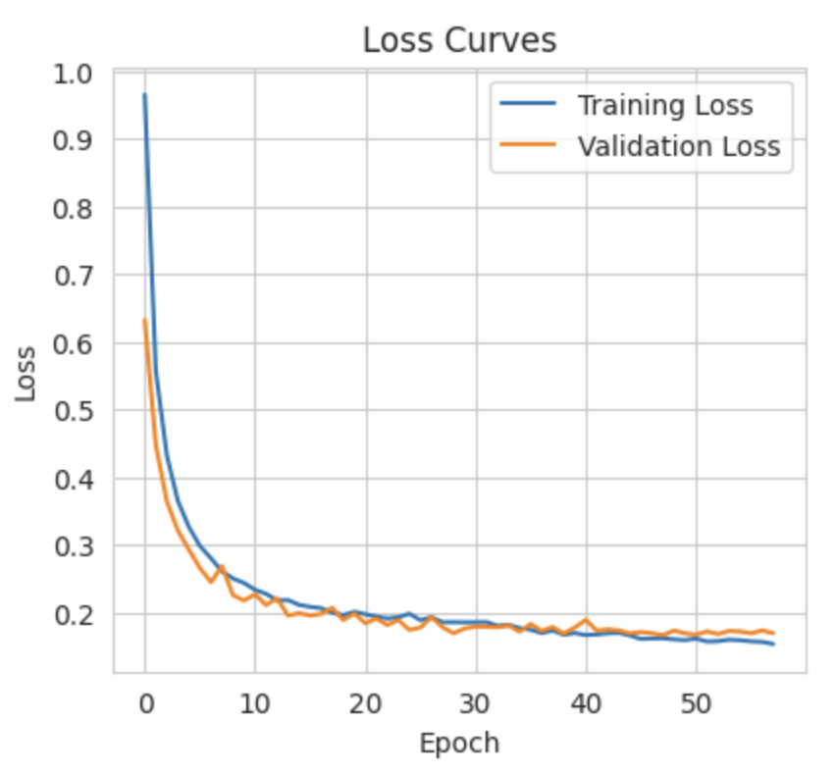
Visualization 1: Training Curve
Takeaway: Decreasing training curves with validation loss consistent with training loss show that the model has effectively learned patterns in the data and is generalizing well.
Note: Early stopping halted training after ~55 epochs due to low marginal decreases in loss (the model typically stops training between epochs 40 and 60).

Slide 12
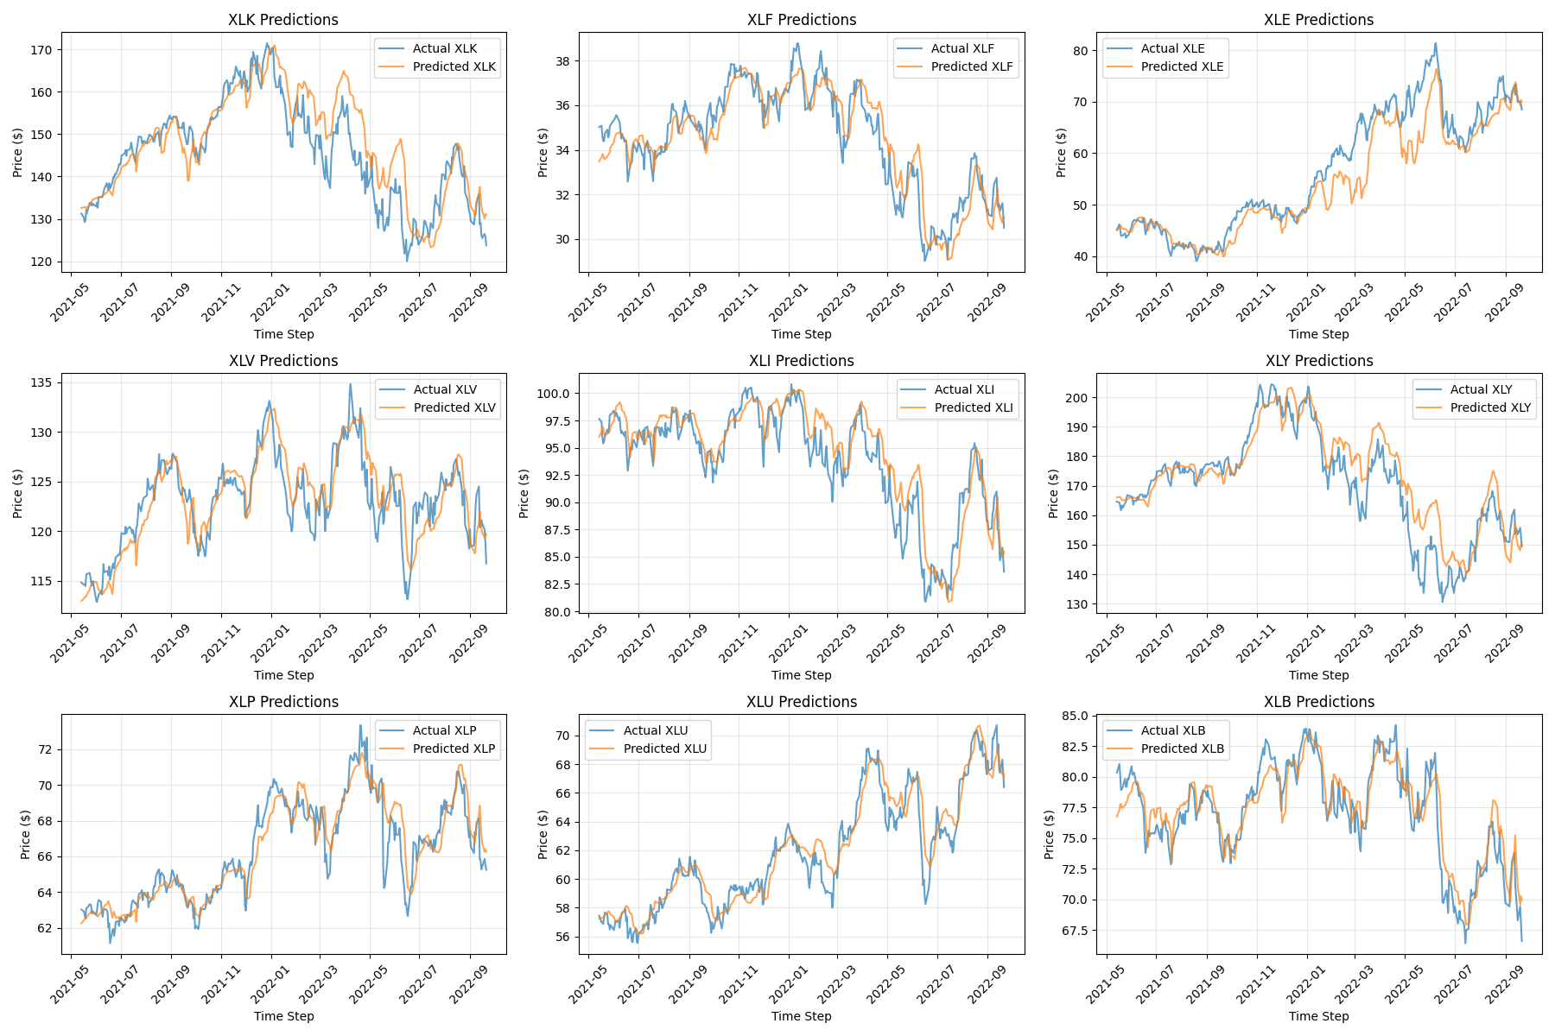
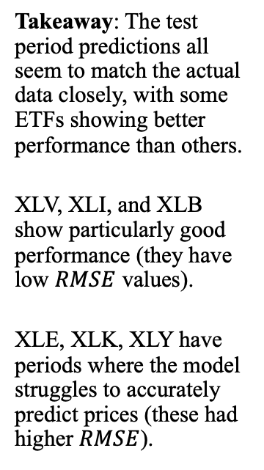
Visualization 2: Test Period Predictions
Takeaway: The test period predictions all seem to match the actual data closely, with some ETFs showing better performance than others.
XLV, XLI, and XLB show particularly good performance (they have low $RMSE$ values).
XLE, XLK, XLY have periods where the model struggles to accurately predict prices (these had higher $RMSE$).

Slide 13
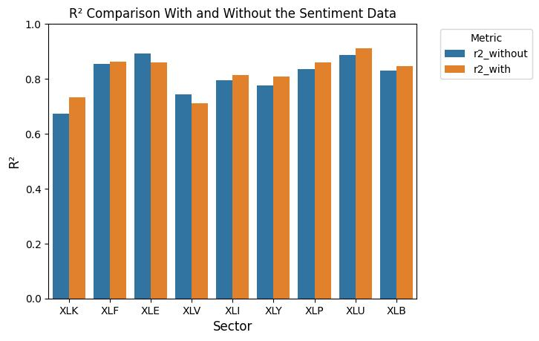
Visualization 3: Comparing model performance with and without sentiment features
Takeaway: Sentiment features provided small but measurable improvements in predictive accuracy for 7 out of the 9 ETFs, with the remaining 2 exhibiting small decreases in performance.
Largest improvements: XLK (technology), XLY (consumer discretionary) - highly-consumer facing industries
Decreased performance: XLE (energy), XLV (health care) - less consumer-facing, more highly driven by government and regulation

Slide 14
Insights & Limitations
Insights:
LSTMs can be effectively used to predict market sector ETFs while accounting for inter-sector dependency with a high degree of predictive accuracy.
Sentiment data improves prediction in industries where consumers are the main drivers of business (technology, consumer discretionary), and less so in sectors where larger-scale change through government regulation drive market movements (energy, healthcare) instead of consumers.
Limitations:
Small amount of news data limited the scope of the model.
Sentiment data was aggregated across news categories → model can’t recognize different sectors’ sentiments, only overall market sentiment.
Given more time, I would attempt to separate the sentiment features by news-category (tech news vs. political news, etc.) to improve the model’s performance. This would require greater access to news headlines data.

Slide 15
Conclusion
A multivariate LSTM predicts 9 ETF next-day prices successfully.
Integrating news headlines reveals which markets’ future performances are more responsive to past investor sentiment.
By predicting a full set of sector prices simultaneously, it produces a data-driven foundation for anticipating short-term cross-market change.

Slide 16
References
Works Cited
Bollen, Johan. “Twitter Mood Predicts the Stock Market.” Science Direct, Elsevier, 2 Feb. 2011, https://www.sciencedirect.com/science/article/pii/S187775031100007X.
Fataliyev, Kamaladdin. “MCASP: Multi-Modal Cross Attention Network for Stock Market Prediction.” ACL Anthology, 1 Nov. 2023, https://aclanthology.org/2023.alta-1.7/.
Li, Zhenglin. “Stock Market Analysis and Prediction Using LSTM: A Case Study on Technology Stocks.” Global Science Publishing, 24 Nov. 2023, https://ojs.sgsci.org/journals/iaet/article/view/162.
Misra, Rishabh. “News Category Dataset.” Kaggle, 24 Sept. 2022, www.kaggle.com/datasets/rmisra/news-category-dataset/data.
“Yfinance Python Package.” PyPI, pypi.org/project/yfinance/.
Image Citations
Chen, James. “Exchange-Traded Fund (ETF): What It Is and How to Invest.” Investopedia, Investopedia, www.investopedia.com/terms/e/etf.asp.
“Huber Loss Function in Machine Learning.” GeeksforGeeks, 1 Aug. 2025, www.geeksforgeeks.org/machine-learning/huber-loss-function-in-machine-learning/.
Stack Overflow, https://stackoverflow.com/#organization, 27 June 2020, stackoverflow.com/questions/62600588/visualize-the-stacked-lstm.

Slide 17
Reflection & Lessons Learned
I anticipated that the model would very easily overfit and thus be difficult to effectively train. My first attempts at model building had extremely high valuations and test error – the model was overfitting, as expected. Accordingly, I experimented with various regularization techniques (dropout, kernel, recurrent, Huber loss function, etc.) and different regularization strengths to help the model better generalize to unseen data.
One problem I did not expect to encounter was the difficulty of extracting, cleaning, and merging my two datasets in order to prepare the data for the model. There were extensive preprocessing steps that were far more time consuming than I anticipated. I would estimate that data cleaning and preparation accounted for ~50% of my time spent on this project.
Some specific lessons that I learned include:
The importance of selecting regularization techniques. Some ideas helped reduce overfitting, others made the model overfit more. Experimentation, documentation of results, and connecting why each technique produced the results it did greatly helped me during the model building phase.
Financial data is extremely difficult to successfully predict, especially when other variables besides price (returns, daily directional movement, etc.) act as the response. Predicting prices - although it has limited use in actual trading scenarios – can help answer more analytical questions to help improve trading decisions.

Slide 18
AI Tools and Assistance
I used ChatGPT to help me learn specific dynamics of the LSTM model, deepening my understanding of how the model works and allowing me to better apply it to this project. Specifically, I was unsure how I could achieve an LSTM model that outputs 9 distinct outputs, so I used ChatGPT to understand the model architecture. I verified the AI-generated output by referring to the course textbook in addition.

Slide 19
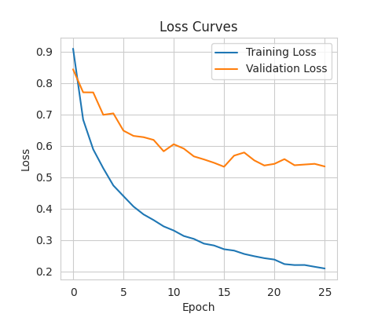
Appendix: Attempted Attention Layer Model
One approach I attempted was to include an additive attention layer between the LSTM layers and the dense layers. Attention allows the model to weigh the impact of different parts of the input sequences on the response. This ideally would have allowed for more in-depth modeling of temporal dependencies.
When fitting this model, the following training curve was produced.
The model with the attention layer greatly overfit the data, even with immense regularization. This is likely due to the increase in model complexity as an effect of the attention layer. The increased number of weights may have made it easy for the model to learn noise, as the training loss consistently decreased while the validation loss plateaued early into training.

